Slide 1
FRONTEND WEB DEVELOPMENT - ADVANCED
Course Orientation

Slide 2
Course Vision
Move from frontend developer to frontend architect
Build scalable, high‑performance applications
Think in terms of architecture, not just UI

Slide 3



Course Vitals
Course: Frontend Web Development Advanced
Duration: 5 Modules + Projects
Approach: Project, Challenge & Peer-Based Learning

Slide 4

Prerequisites
HTML, CSS, JavaScript fundamentals
Basic DOM manipulation
Git, VS Code, terminal familiarity

Slide 5
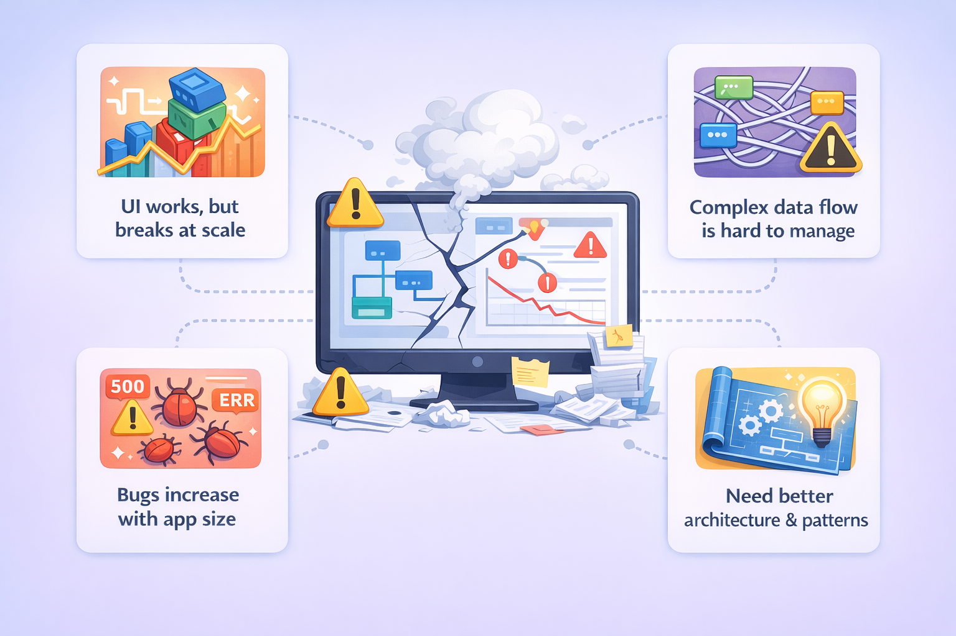
The Architect’s Dilemma

Slide 6
THE 5 MODULE JOURNEY
"Each module builds on previous
- miss one, struggle with next"

Slide 7
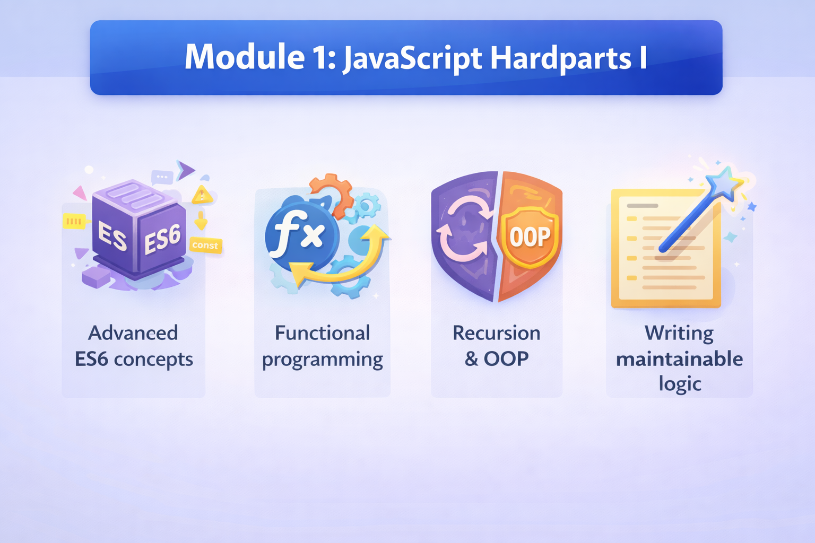
Foundation (JavaScript mastery)

Slide 8
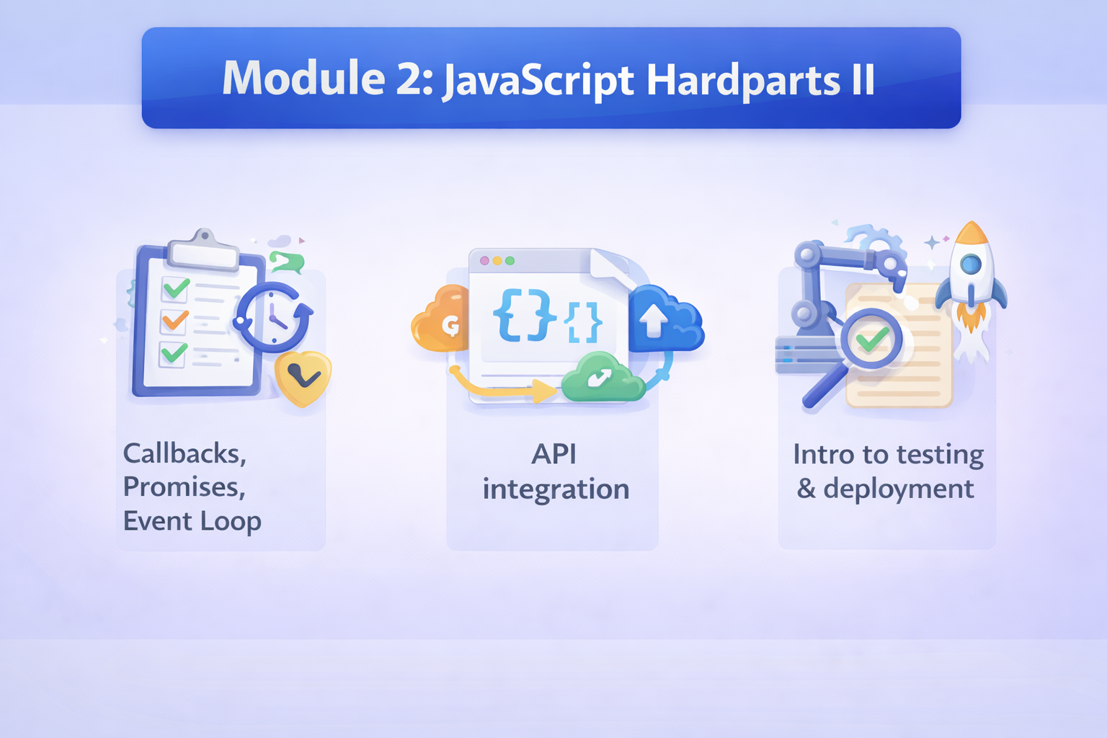
Foundation (JavaScript mastery)

Slide 9
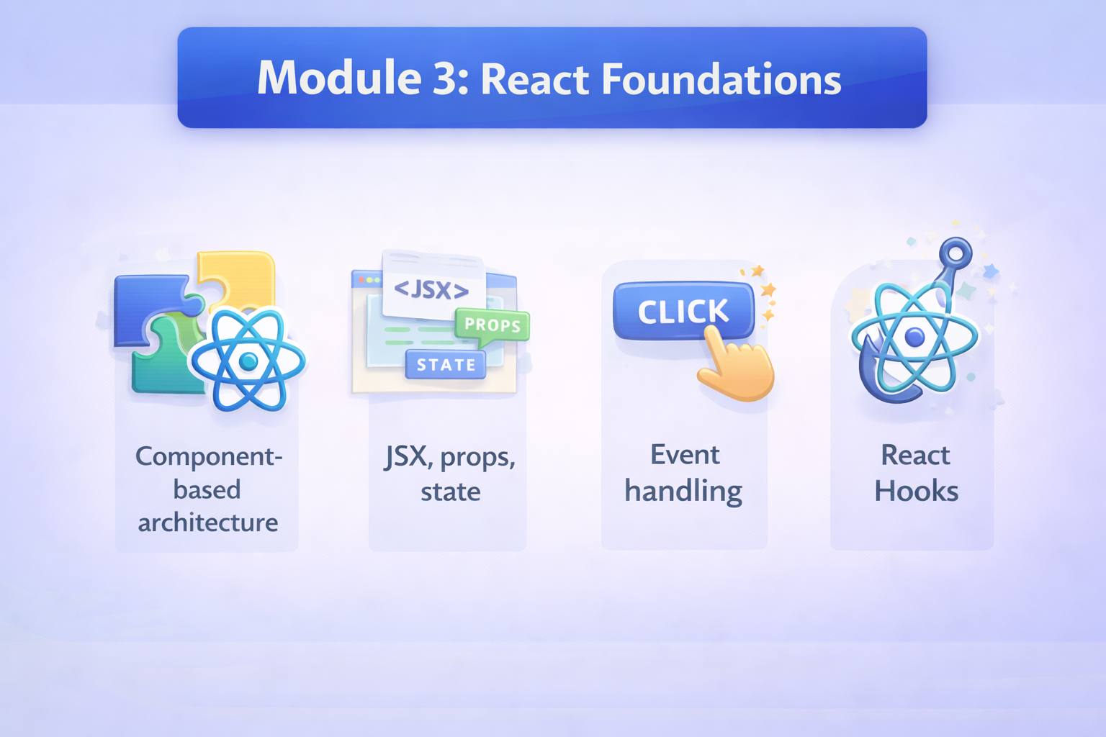
Framework (React basics)

Slide 10
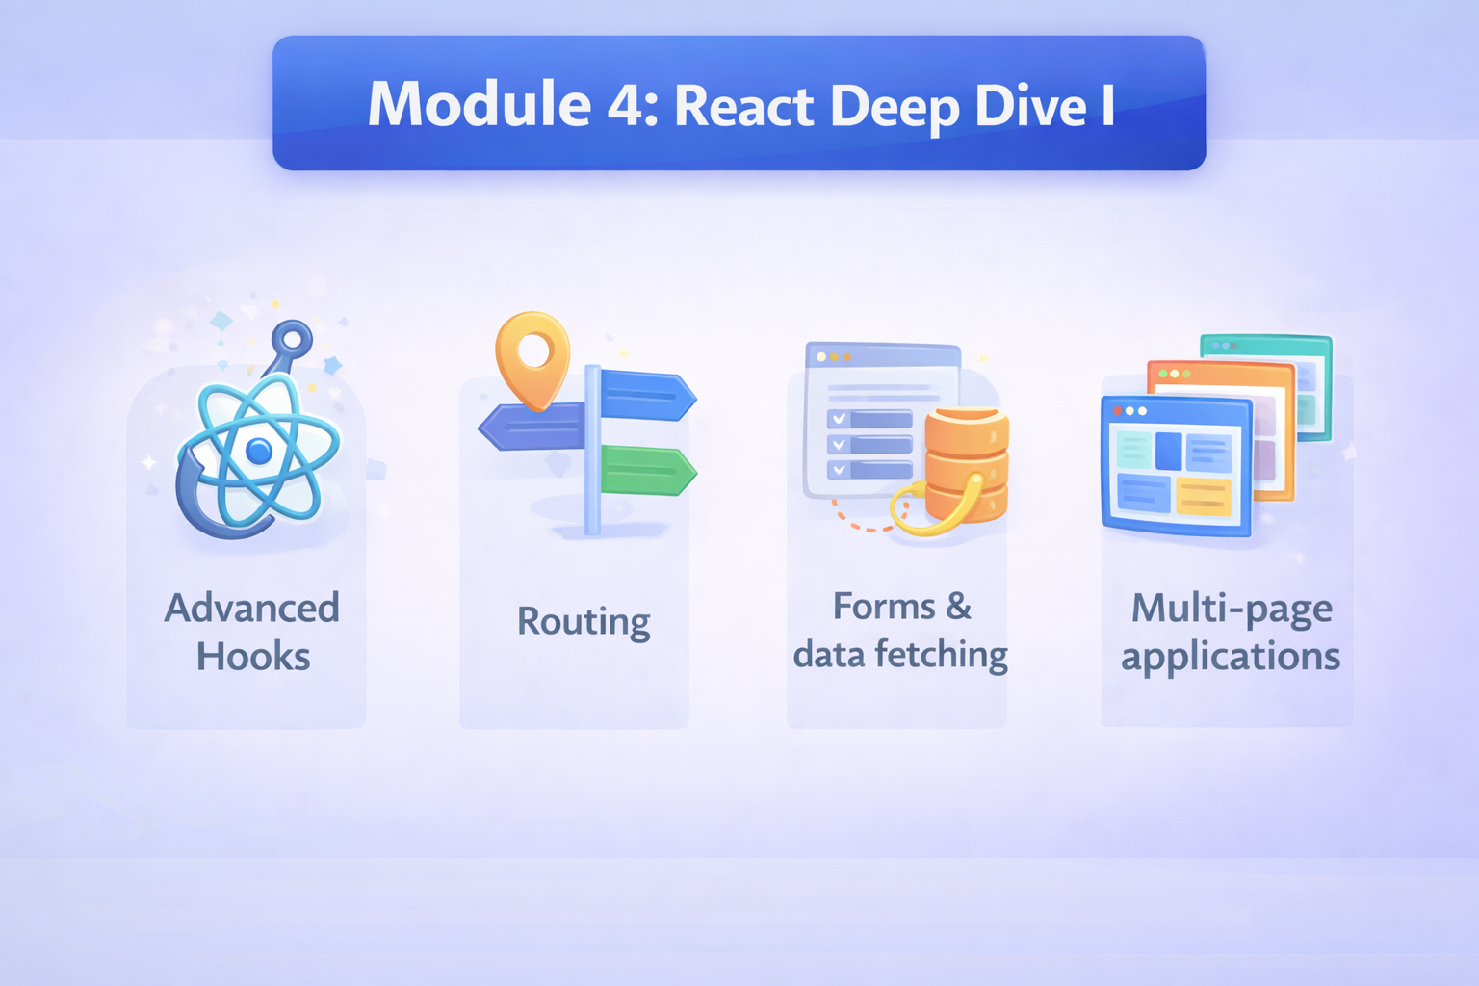
Interior (Complex UI features)

Slide 11
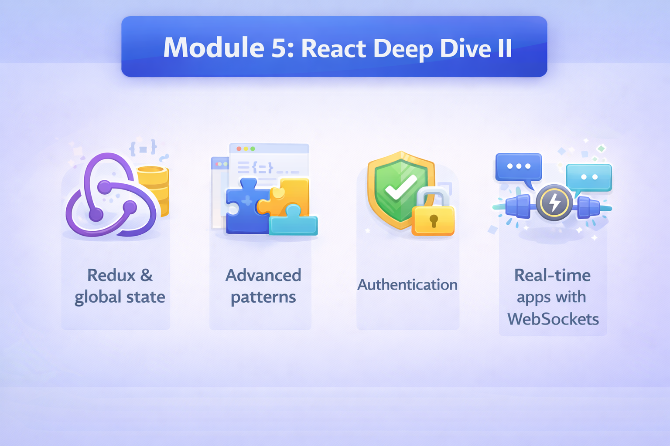
Smart Systems (State management, real-time, auth)

Slide 12
Assessments
Quizzes:
Regular quizzes will test your understanding of core concepts, syntax, and theoretical principles covered in each learning unit and module. These are designed to help you self-assess and solidify foundational knowledge.
Programming Multi-File (PMF) Assignments:
These assignments will challenge you to build features or small applications requiring you to manage code across multiple files and modules, simulating real-world project structures. This assesses your ability to organize code and understand dependencies.
File Upload Questions / Projects:
For larger projects and module-ending assessments, you will submit your complete codebase (e.g., as a zip file or GitHub repository link). This allows for a holistic evaluation of your architectural choices, code quality, functionality, and adherence to best practices.

Slide 13
Mentor-led vs Mentor-guided sessions
Mentor-led sessions (Earlier called Live Sessions)
Mentor leads the session fully, explains concepts, and guides discussions.
You participate, ask questions, and practice in real-time.
Why it matters: You gain clarity, confidence, and hands-on understanding from guided learning.
Mentor-guided sessions (Earlier called Self-Learning Sessions)
Mentor gives a short introduction, then you learn by yourself - with the mentor available to guide you.
If something is unclear, you reach out to the mentor to get clarity. Why it matters: You control your learning. It trains you to think independently, solve problems, and learn actively.
Mentor Led sessions = understand and apply; Mentor guided sessions = explore and question
Both are essential to truly grasp the subject and build skills.

Slide 14
Final Takeaway
Think beyond UI
Design for scale
Make intentional decisions
Build like an architect

